Slide 1
COURSE PROJECT • PROTOTYPE
StitchPerfect
Digital Tailor Shop Management System
Uday Singh
Roll No: 1024160031
Project Overview
Prototype Milestone
Digital management of tailor-shop records
Measurement and order management
Admin and Worker workflows
Manual and ML-assisted measurement entry
Frontend approximately 50% completed
Admin and Worker interfaces under development
Measurement predictor workflow established
Backend and database integration upcoming

Slide 2
SYSTEM ARCHITECTURE & METHODOLOGY
System Architecture: Digital Tailor Management Flow
Tier 1: User Interface
Tier 2: Application Layer
Tier 3: Data & Intelligence
HTML
CSS
JavaScript
Bootstrap
Admin Dashboard
Worker Console
Node.js
Express.js
Authentication
Order management
Measurement management
MySQL
Measurement records
ML Measurement Predictor
Prediction verification
End-to-End Flow
Admin / Worker
Login
Dashboard
Measurements /
Orders
Database
Worker
Assignment
Order Status

Slide 3
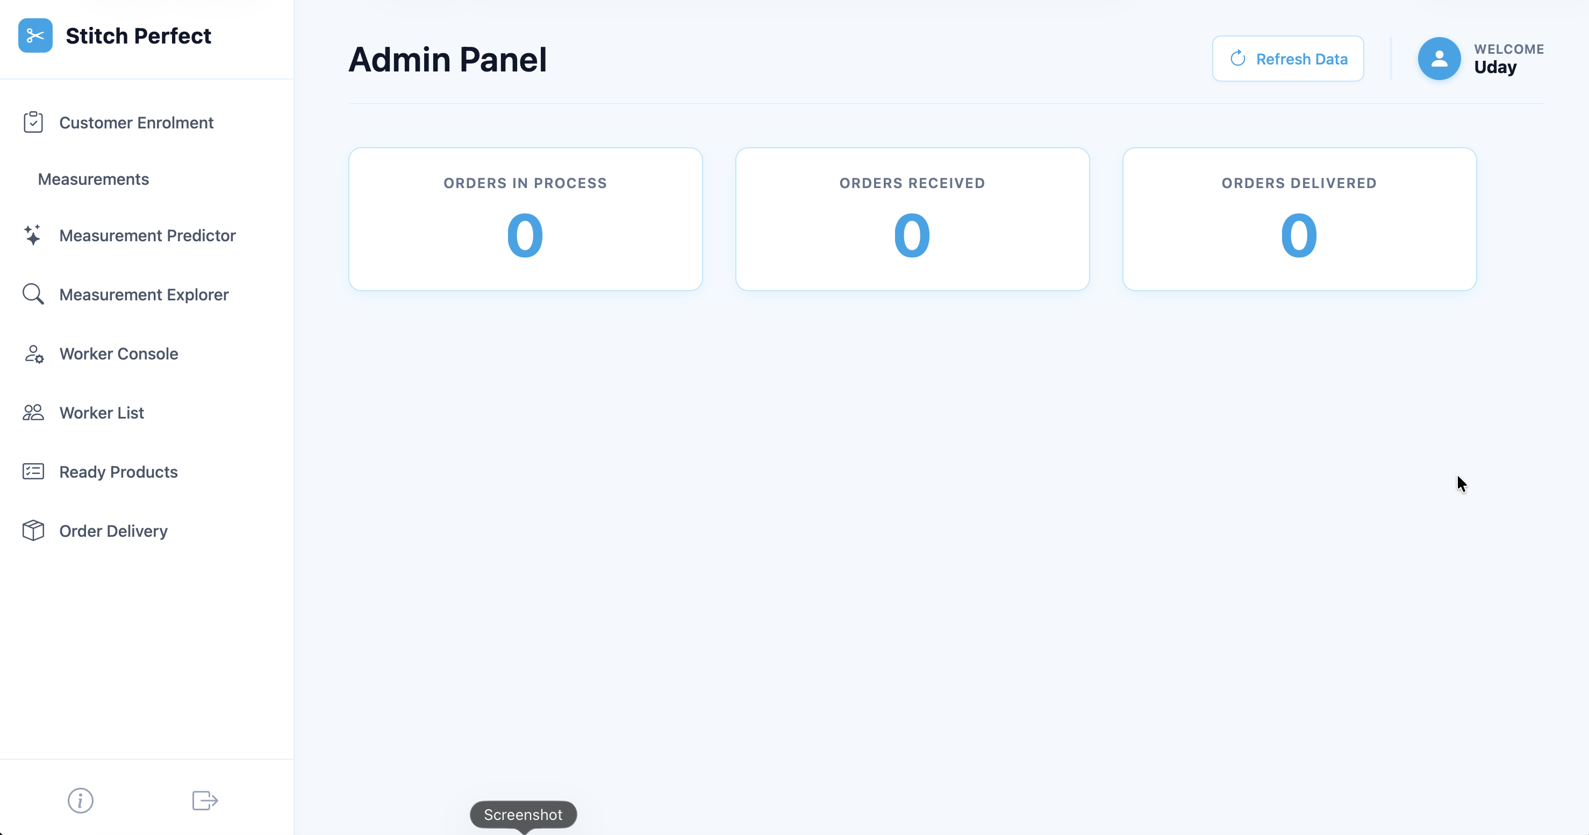
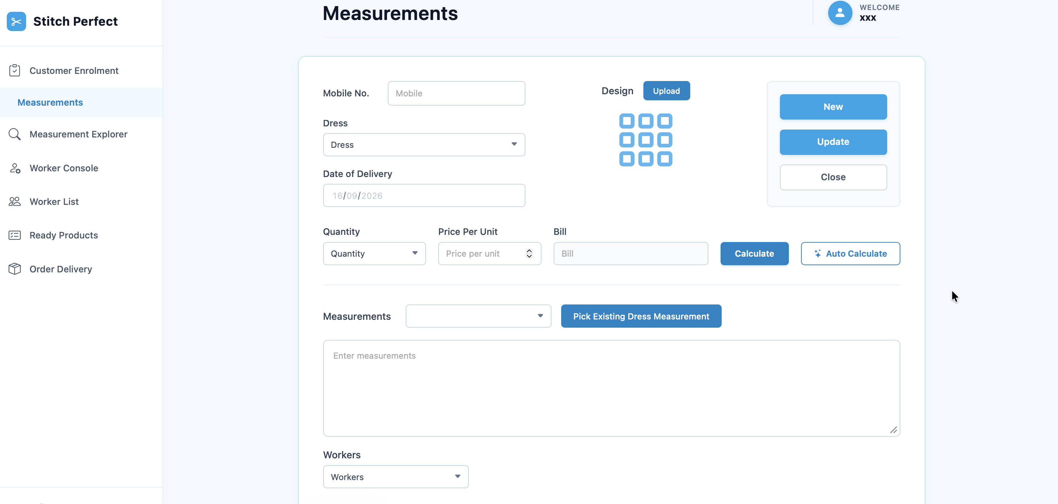
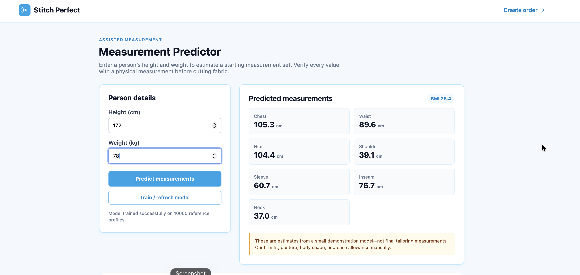
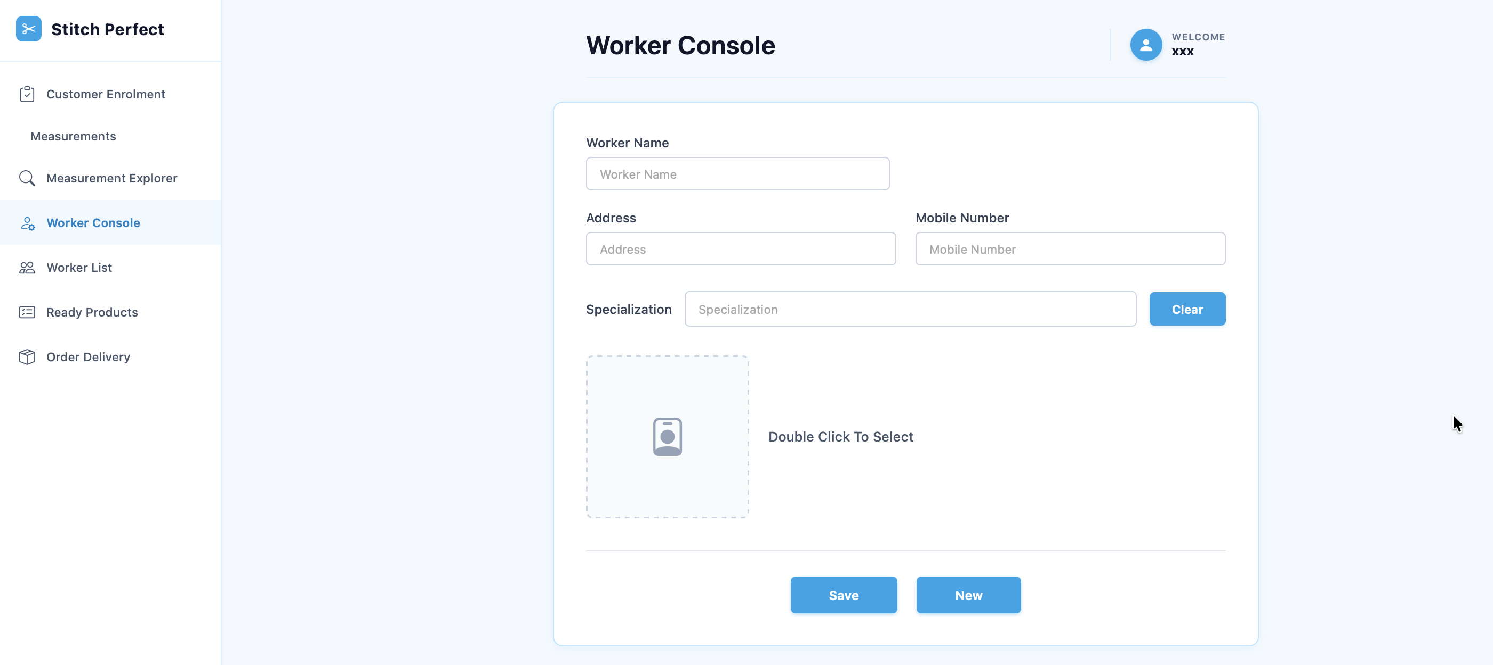
PROTOTYPE RESULTS & DEMONSTRATION
Prototype Results: Frontend Implementation
Demonstration of the current StitchPerfect prototype
Screenshot placeholder
(replace with prototype capture)
Screenshot placeholder
(replace with prototype capture)
1. Admin Dashboard
2. Measurement Interface
Screenshot placeholder
(replace with prototype capture)
Screenshot placeholder
(replace with prototype capture)
Measurement Predictor
4. Worker Console

Slide 4
PROTOTYPE WORKFLOW
End-to-End Order Journey
LOGIN
SELECT ROLE
ADMIN
WORKER
Dashboard
Worker Console
Manual Measurement / Predictor
Verify Measurements
Create Order
Assign Worker
Stitching
Update Status
ORDER COMPLETED

Slide 5
BENCHMARKS & ROADMAP
Development Progress & Roadmap
Current Prototype Progress
Development Roadmap
Project Ideation
Phase 1 — Ideation
Completed
100%
Requirement Analysis
Phase 2 — Requirements & Planning
Completed
100%
UI/UX Planning
Phase 3 — UI/UX Design
Completed
100%
Frontend Development
50%
Phase 4 — Frontend Development
50% Completed
Backend Development
Upcoming
Phase 5 — Backend Completion
Upcoming
Predictor Accuracy Improvement
Upcoming
Phase 6 — Predictor Accuracy Improvement
Upcoming

